Slide 1
Fundamentals Physics
Tenth Edition
Halliday
Chapter 3
Vectors

Slide 2

3-1 Vectors and Their Components (1 of 15)
Learning Objectives
3.01 Add vectors by drawing them in head-to-tail arrangements, applying the commutative and associative laws.
3.02 Subtract a vector from a second one.
3.03 Calculate the components of a vector on a given coordinate system, showing them in a drawing.
3.04 Given the components of a vector, draw the vector and determine its magnitude and orientation.
3.05 Convert angle measures between degrees and radians.

Slide 3
3-1 Vectors and Their Components (2 of 15)
Physics deals with quantities that have both size and direction
A vector is a mathematical object with size and direction
A vector quantity is a quantity that can be represented by a vector
Examples: position, velocity, acceleration
Vectors have their own rules for manipulation
A scalar is a quantity that does not have a direction
Examples: time, temperature, energy, mass
Scalars are manipulated with ordinary algebra

Slide 4
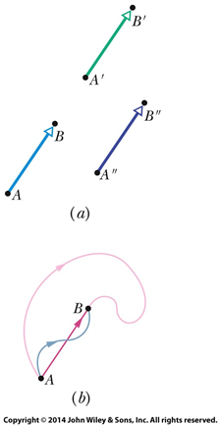
3-1 Vectors and Their Components (3 of 15)
The simplest example is a displacement vector
If a particle changes position from A to B, we represent this by a vector arrow pointing from A to B
In (a) we see that all three arrows have the same magnitude and direction: they are identical displacement vectors.
In (b) we see that all three paths correspond to the same displacement vector. The vector tells us nothing about the actual path that was taken between A and B.
Figure 3-1

Slide 5
3-1 Vectors and Their Components (4 of 15)
The vector sum, or resultant
Is the result of performing vector addition
Represents the net displacement of two or more displacement vectors
Equation (3-1)
Can be added graphically as shown:

Slide 6
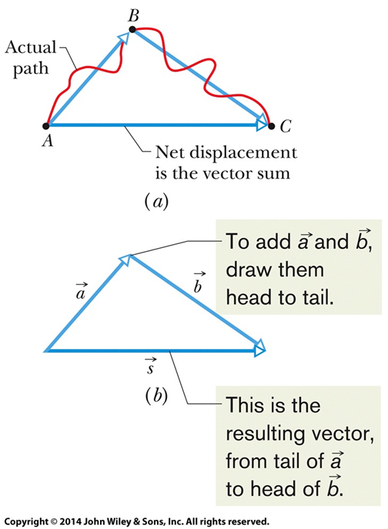
3-1 Vectors and Their Components (5 of 15)
Figure 3-2

Slide 7
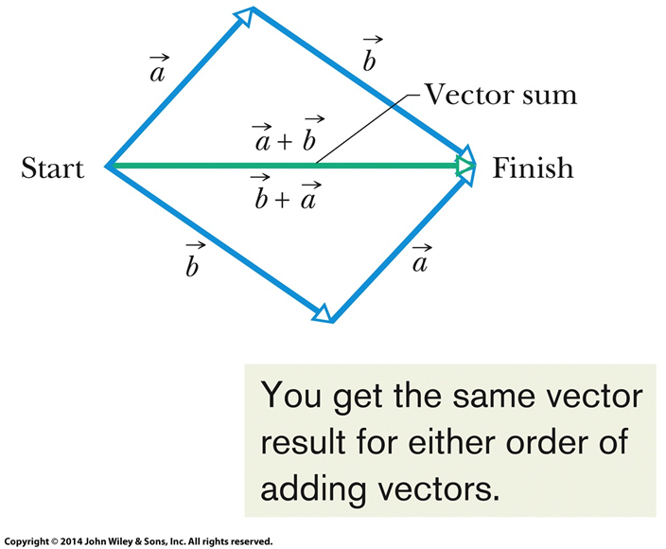
3-1 Vectors and Their Components (6 of 15)
Vector addition is commutative
We can add vectors in any order
Equation (3-2)
Figure (3-3)

Slide 8
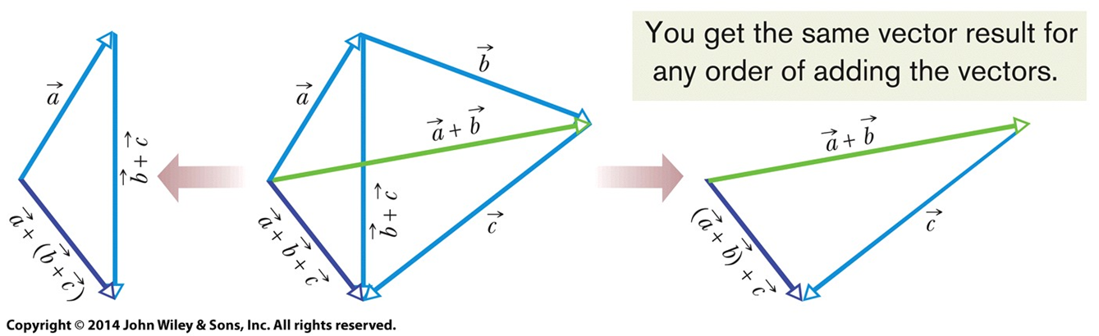
3-1 Vectors and Their Components (7 of 15)
Vector addition is associative
We can group vector addition however we like
Equation (3-3)
Figure (3-4)

Slide 9
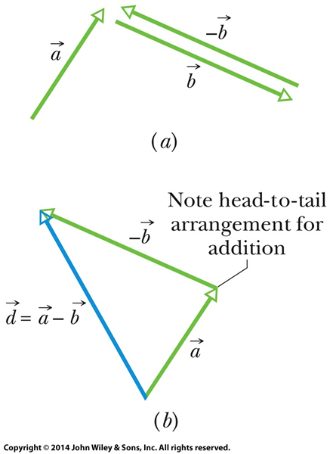
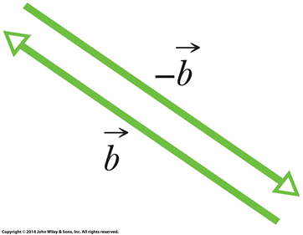
3-1 Vectors and Their Components (8 of 15)
A negative sign reverses vector direction
We use this to define vector subtraction
Equation (3-4)
Figure (3-5)
Figure (3-6)

Slide 10
3-1 Vectors and Their Components (9 of 15)
These rules hold for all vectors, whether they represent displacement, velocity, etc.
Only vectors of the same kind can be added
(distance) + (distance) makes sense
(distance) + (velocity) does not

Slide 11
3-1 Vectors and Their Components (10 of 15)
Checkpoint 1
The magnitudes of displacements
are 3 m and 4 m,
respectively, and
Considering various orientations of
what are (a) the maximum possible magnitude for
and (b) the minimum possible magnitude?
Answer:
(a) 3 m + 4 m = 7 m
(b) 4 m − 3 m = 1 m

Slide 12
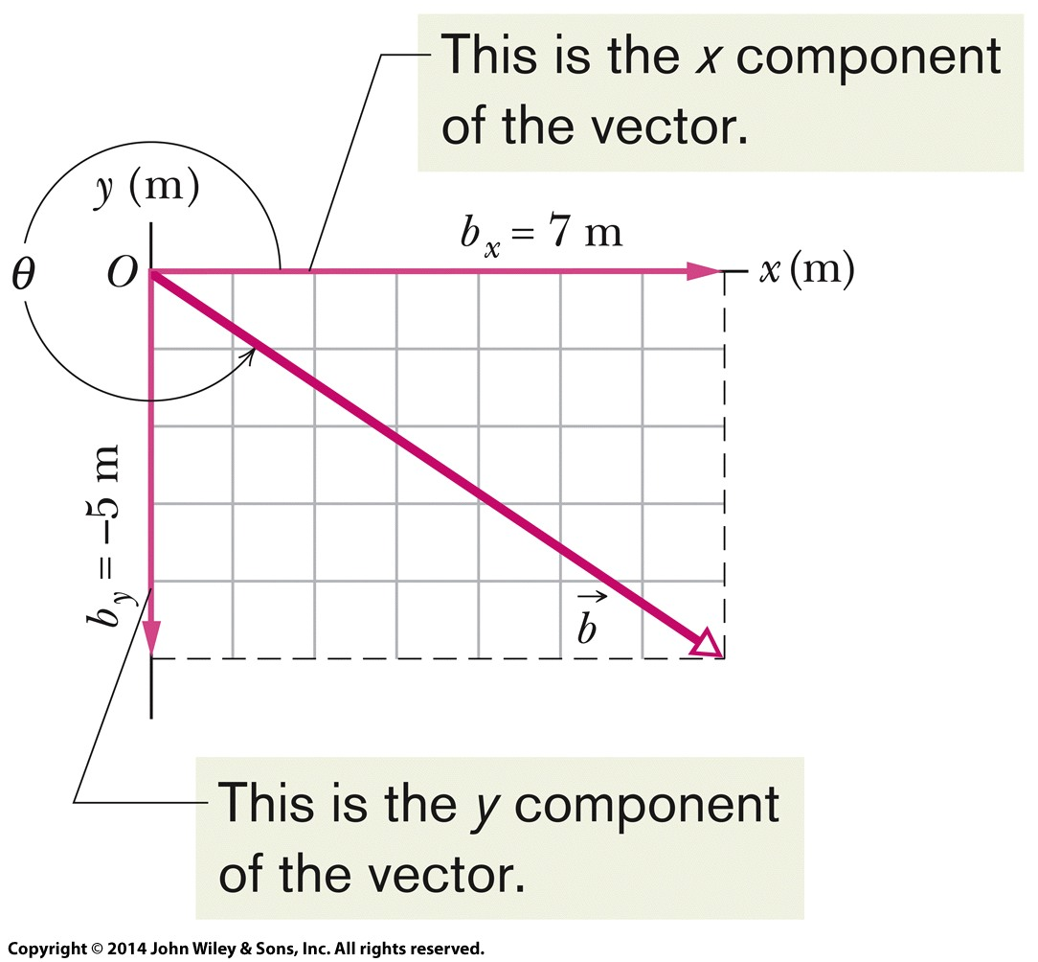
3-1 Vectors and Their Components (11 of 15)
Rather than using a graphical method, vectors can be added by components
A component is the projection of a vector on an axis
The process of finding components is called resolving the vector
The components of a vector can be positive or negative.
They are unchanged if the vector is shifted in any direction (but not rotated).
Figure (3-8)

Slide 13
3-1 Vectors and Their Components (12 of 15)
Components in two dimensions can be found by:
Equation (3-5)
Where θ is the angle the vector makes with the positive x axis, and a is the vector length
The length and angle can also be found if the components are known
Equation (3-6)
Therefore, components fully define a vector

Slide 14
3-1 Vectors and Their Components (13 of 15)
In the three dimensional case we need more components to specify a vector

Slide 15
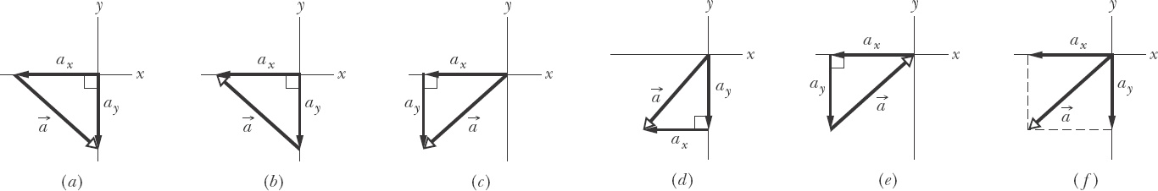
3-1 Vectors and Their Components (14 of 15)
Checkpoint 2
In the figure, which of the indicated methods for
combining the x and y components of vector
are proper
to determine that vector?
Answer: choices (c), (d), and (f) show the components properly arranged to form the vector

Slide 16
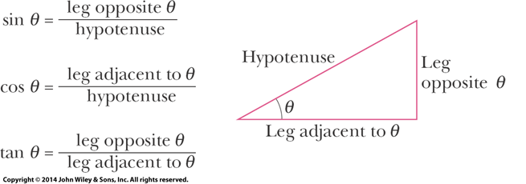
3-1 Vectors and Their Components (15 of 15)
Angles may be measured in degrees or radians
Recall that a full circle is 360˚, or
Know the three basic trigonometric functions
Figure (3-11)

Slide 17
3-2 Unit Vectors, Adding Vectors by Components (1 of 8)
Learning Objectives
3.06 Convert a vector between magnitude-angle and unit-vector notations.
3.07 Add and subtract vectors in magnitude-angle notation and in unit-vector notation.
3.08 Identify that, for a given vector, rotating the coordinate system about the origin can change the vector's components, but not the vector itself.

Slide 18
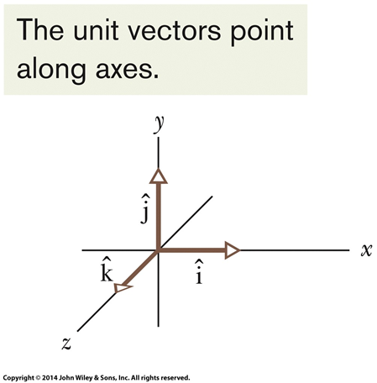
3-2 Unit Vectors, Adding Vectors by Components (2 of 8)
A unit vector
Has magnitude 1
Has a particular direction
Lacks both dimension and unit
Is labeled with a hat:
Equation (3-7)
Equation (3-8)
We use a right-handed coordinate system
Remains right-handed when rotated
Figure (3-13)

Slide 19
3-2 Unit Vectors, Adding Vectors by Components (3 of 8)
The quantities a_{x}i and a_{y}j are vector components
Equation (3-7)
Equation (3-8)
The quantities a_{x} and a_{y} alone are scalar components
Or just “components” as before

Slide 20
3-2 Unit Vectors, Adding Vectors by Components (4 of 8)
Vectors can be added using components
Equation (3-9)
Equation (3-10)
Equation (3-11)
Equation (3-12)

Slide 21
3-2 Unit Vectors, Adding Vectors by Components (5 of 8)
To subtract two vectors, we subtract components
Equation (3-13)

Slide 22
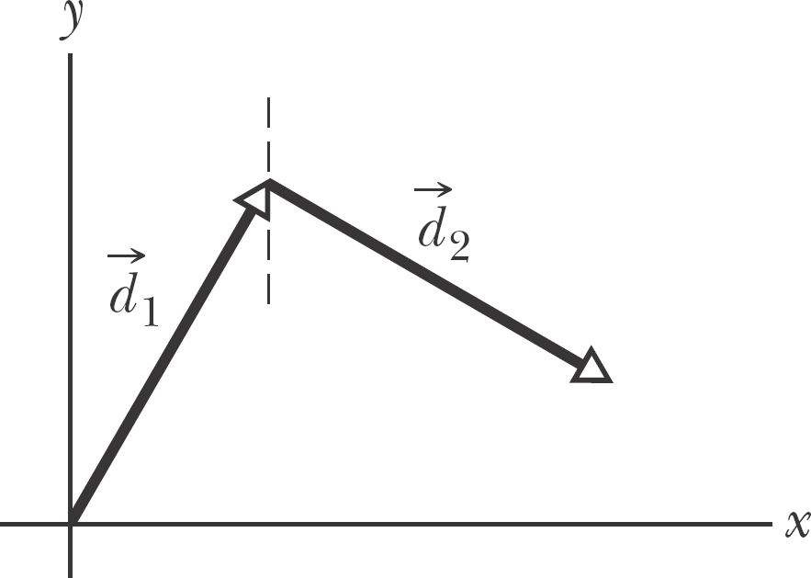
3-2 Unit Vectors, Adding Vectors by Components (6 of 8)
Checkpoint 3
(a) In the figure here, what are the signs of the x components of
(b) What are the signs of the y components of
(c) What are the signs of the x and y components of
Answer:
(a) positive, positive
(b) positive, negative
(c) positive, positive

Slide 23
3-2 Unit Vectors, Adding Vectors by Components (7 of 8)
Vectors are independent of the coordinate system used to measure them
We can rotate the coordinate system, without rotating the vector, and the vector remains the same
Equation (3-14)
Equation (3-15)
All such coordinate systems are equally valid

Slide 24
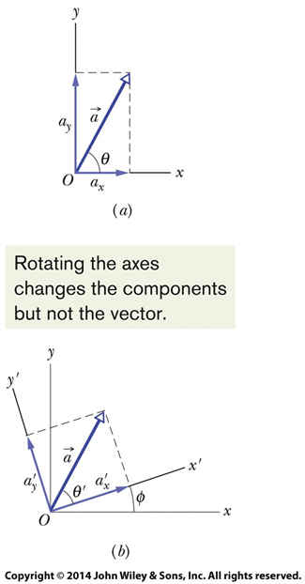
3-2 Unit Vectors, Adding Vectors by Components (8 of 8)
Figure (3-15)

Slide 25
3-3 Multiplying Vectors (1 of 13)
Learning Objectives
3.09 Multiply vectors by scalars.
3.10 Identify that multiplying a vector by a scalar gives a vector, the dot product gives a scalar, and the cross product gives a perpendicular vector.
3.11 Find the dot product of two vectors.
3.12 Find the angle between two vectors by taking their dot product.
3.13 Given two vectors, use the dot product to find out how much of one vector lies along the other.

Slide 26
3-3 Multiplying Vectors (2 of 13)
3.14 Find the cross product of two vectors.
3.15 Use the right-hand rule to find the direction of the resultant vector.
3.16 In nested products, start with the innermost product and work outward.

Slide 27
3-3 Multiplying Vectors (3 of 13)
Multiplying a vector z by a scalar c
Results in a new vector
Its magnitude is the magnitude of vector z times
Its direction is the same as vector z, or opposite if c is negative
To achieve this, we can simply multiply each of the components of vector z by c
To divide a vector by a scalar we multiply by

Slide 28
3-3 Multiplying Vectors (4 of 13)
Example Multiply vector z by 5
z = −3i + 5j
5z = −15i + 25j

Slide 29
3-3 Multiplying Vectors (5 of 13)
Multiplying two vectors: the scalar product
Also called the dot product
Results in a scalar, where a and b are magnitudes and
is the angle between the directions of the two vectors:
Equation (3-20)
The commutative law applies, and we can do the dot product in component form
Equation (3-22)
Equation (3-23)

Slide 30
3-3 Multiplying Vectors (6 of 13)
A dot product is: the product of the magnitude of one vector times the scalar component of the other vector in the direction of the first vector
Equation (3-21)
Either projection of one vector onto the other can be used
To multiply a vector by the projection, multiply the magnitudes

Slide 31
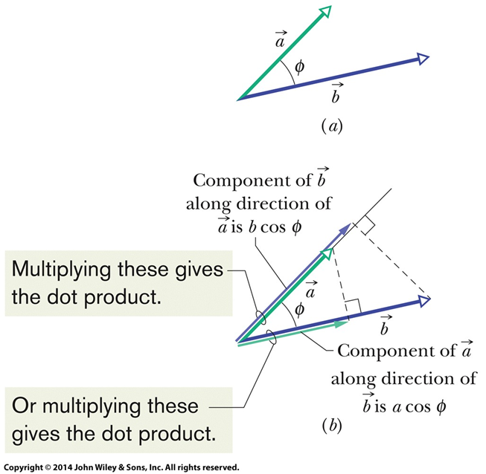
3-3 Multiplying Vectors (7 of 13)
Figure (3-18)

Slide 32
3-3 Multiplying Vectors (8 of 13)
If the angle
between two vectors is 0°, the component of one
vector along the other is maximum, and so also is the dot product of
the vectors. If, instead,
is 90°, the component of one vector
along the other is zero, and so is the dot product.
Checkpoint 4
Vectors
have magnitudes of 3 units and 4 units,
respectively. What is the angle between the directions of
if
equals (a) zero, (b) 12 units, and (c) −12 units?
Answer:
(a) 90 degrees
(b) 0 degrees
(c) 180 degrees

Slide 33
3-3 Multiplying Vectors (9 of 13)
Multiplying two vectors: the vector product
The cross product of two vectors with magnitudes a & b,
separated by angle
produces a vector with magnitude:
Equation (3-24)
And a direction perpendicular to both original vectors
Direction is determined by the right-hand rule
Place vectors tail-to-tail, sweep fingers from the first to the second, and thumb points in the direction of the resultant vector

Slide 34
3-3 Multiplying Vectors (10 of 13)
If
are parallel or antiparallel,
The magnitude of
which can be written as
is maximum when
are perpendicular to each other.

Slide 35
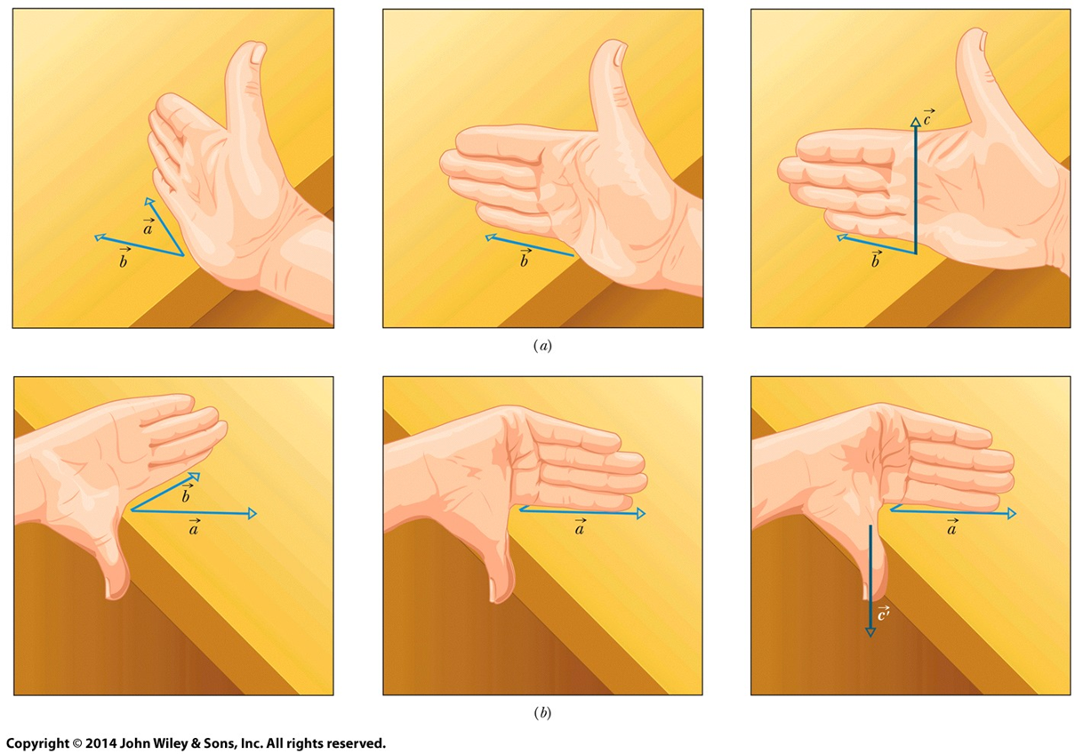
3-3 Multiplying Vectors (11 of 13)
Figure (3-19)
The upper shows vector a cross vector b, the lower shows vector b cross vector a

Slide 36
3-3 Multiplying Vectors (12 of 13)
The cross product is not commutative
Equation (3-25)
To evaluate, we distribute over components:
Equation (3-26)
Therefore, by expanding (3-26):
Equation (3-27)

Slide 37
3-3 Multiplying Vectors (13 of 13)
Checkpoint 5
Vectors
have magnitudes of 3 units and 4 units,
respectively. What is the angle between the directions of
if the magnitude of the vector product
is (a) zero and (b) 12 units?
Answer:
(a) 0 degrees
(b) 90 degrees

Slide 38
3 Summary (1 of 4)
Scalars and Vectors
Scalars have magnitude only
Vectors have magnitude and direction
Both have units!
Vector Components
Given by
Equation (3-5)
Related back by
Equation (3-6)

Slide 39
3 Summary (2 of 4)
Adding Geometrically
Obeys commutative and associative laws
Equation (3-2)
Equation (3-3)
Unit Vector Notation
We can write vectors in terms of unit vectors
Equation (3-7)

Slide 40
3 Summary (3 of 4)
Adding by Components
Add component-by-component
Equations (3-10) - (3-12)
Scalar Product
Dot product
Equation (3-20)
Equation (3-22)

Slide 41
3 Summary (4 of 4)
Scalar Times a Vector
Product is a new vector
Magnitude is multiplied by scalar
Direction is same or opposite
Cross Product
Produces a new vector in perpendicular direction
Direction determined by right-hand rule
Equation (3-24)

Slide 42
Copyright
Copyright © 2018 John Wiley & Sons, Inc.
All rights reserved. Reproduction or translation of this work beyond that permitted in Section 117 of the 1976 United States Act without the express written permission of the copyright owner is unlawful. Request for further information should be addressed to the Permissions Department, John Wiley & Sons, Inc. The purchaser may make back-up copies for his/her own use only and not for distribution or resale. The Publisher assumes no responsibility for errors, omissions, or damages, caused by the use of these programs or from the use of the information contained herein.

